Slide 1
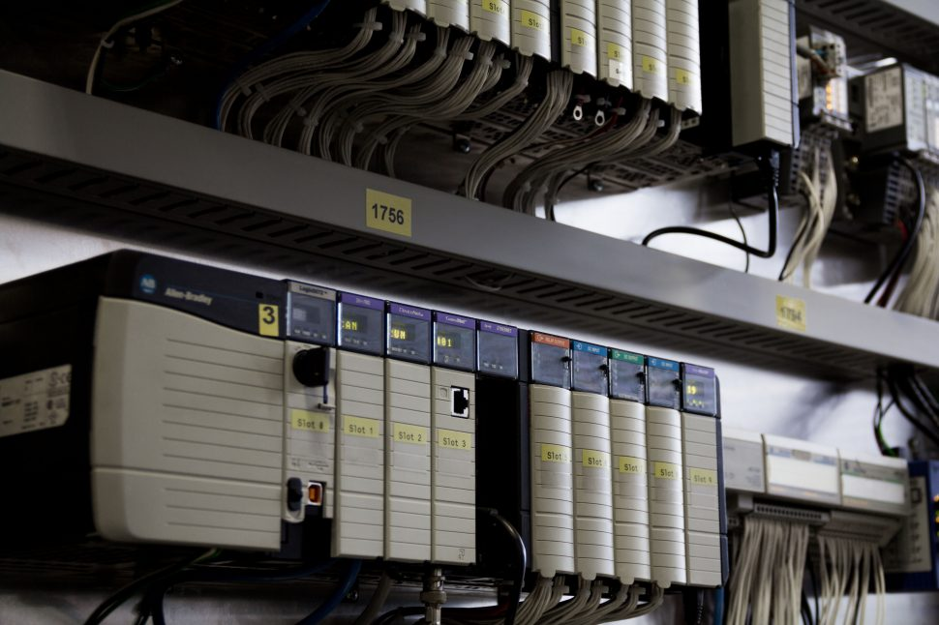
Plc 301 Intelligrated plc controls
Kurt Kimnach
Intelligrated tech support
december 2019

Slide 2
Plc controls -plc areas -Connection -inputs / outputs -code structure

Slide 3
PLC controls
PLC controlled areas vs. ICW
Controller config
Connect to demo PLC
Program tags
Local tags
produce consume
Tasks – Routines etc
AOIs - navigating

Slide 4
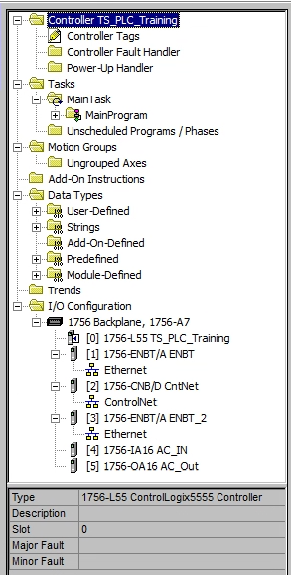
Plc controlled areas
Most MHE conveyor in Amazon sites
Multiple control panels per PLC
I/O Configuration: Direct I/O, MDR slaves, EthIP drives, ZoneFlex Managers

Slide 5
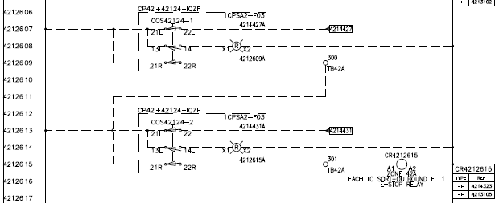
Plc controlled areas – E-Stops
Emergency Stop circuits:
Multiple stations per zone/relay
Line-of-sight rule
MDR may invoke via software.
Interlocks from other panels – !!Orange Wire!!

Slide 6
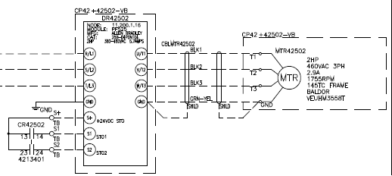
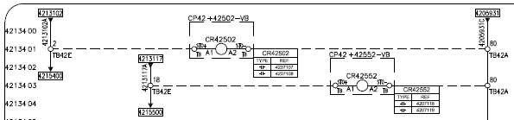
Plc controlled areas
Drive E-Stops and STO circuits:
120V relays from panel E-Stop circuits contained in Junction boxes on conveyor to switch 24V STO.

Slide 7
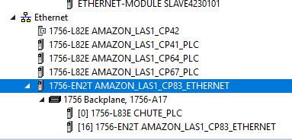
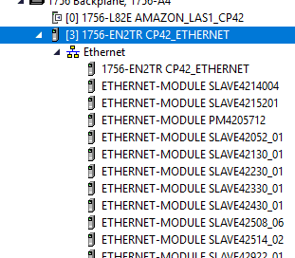
PLC connection
Ethernet – plant networks
Example: LAS1
Plant-Wide Network:
10.19.198.X
Local controls devices (CP42):
11.200.1.X
Can add modules to Ethernet config in RSLinx

Slide 8
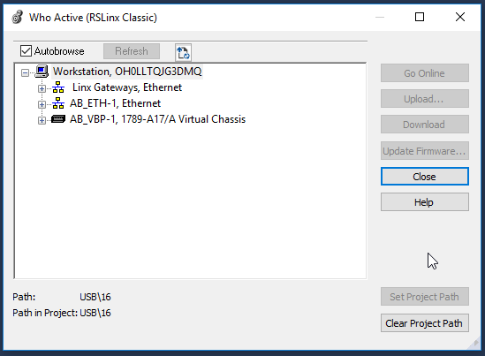
PLC connection
Review connection:
Communications – Who Active
Go Online
Upload…
Download – NOT IN PRODUCTION!!
Set Project Path

Slide 9
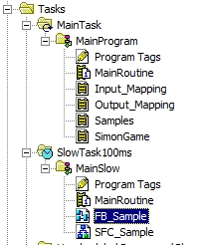
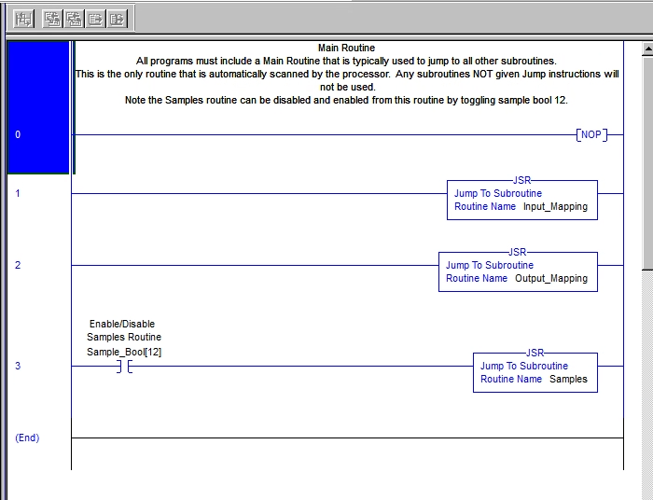
Project routine flow
Task – Program – Routine
Main Task usually Continuous
Each Program has Main Routine
Scheduling can be multi-layer
How to tell if routine is active?

Slide 10
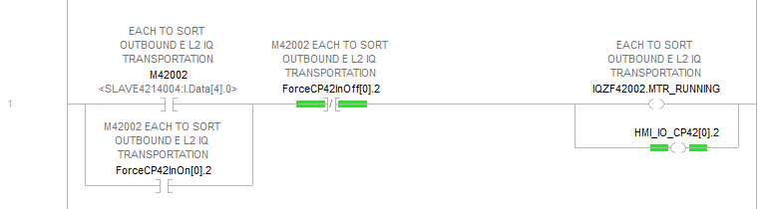
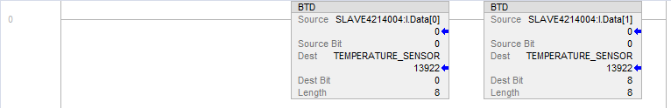

Plc inputs / Outputs
Dedicated routines for all in/out
‘Raw’ tags are labeled by the Slave device name.
Examples at left:
Digital, Analog, Drive
Note Alias designations
Digital I/O have force bits.
Toggle to force vs. RS Force

Slide 11
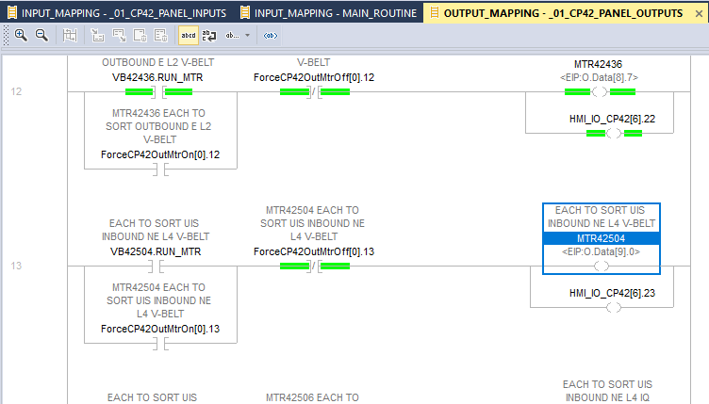
Plc troubleshooting
Logic back-tracing:
Start at the end.
What is not working correctly?
Example: MTR42504 is not running
Look at rung – what is FALSE (not green)?
VB42504.RUN_MTR

Slide 12
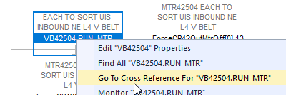
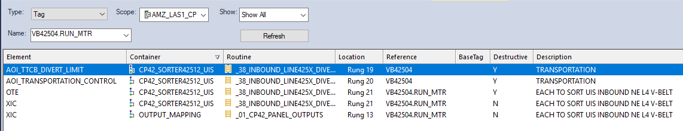
Plc troubleshooting
VB42504.RUN_MTR
Cross Reference – What is Destructive?
(AOIs may be distraction)

Slide 13
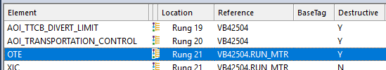
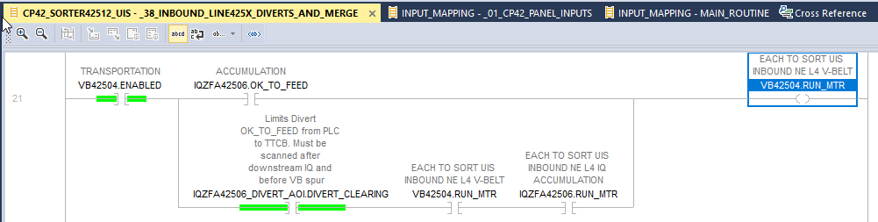
Plc troubleshooting
The OTE in this case is highly probable.
Once again – what is not Green?
IQZFA42506.OK_TO_FEED and
IQZFA42506.RUN_MTR

Slide 14
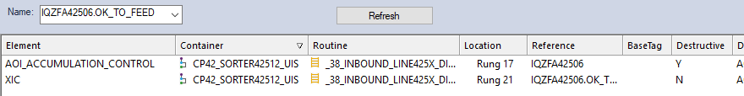
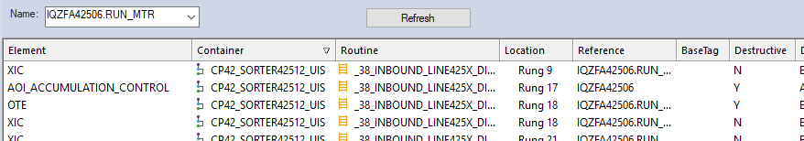
PLC troubleshooting
IQZFA42506.OK_TO_FEED and
IQZFA42506.RUN_MTR
.RUN_MTR has an OTE – we’ll check that first…

Slide 15
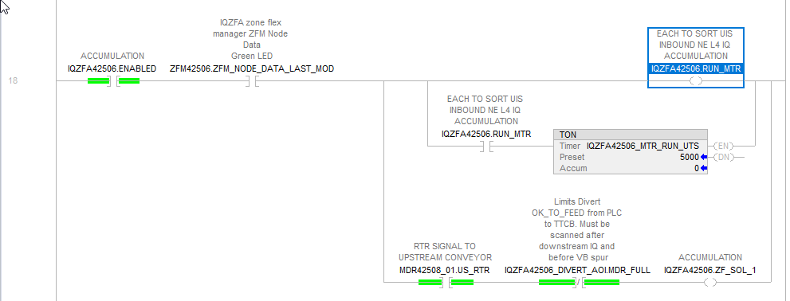
Plc troubleshooting
On with the pattern:
What is not TRUE(Green)?
ZFM_NODE_DATA_LAST_MOD
(no data from the ZFM)
Since this is emulation, and I know the ZFMs are not there, I’ll fix this
and check again…

Slide 16
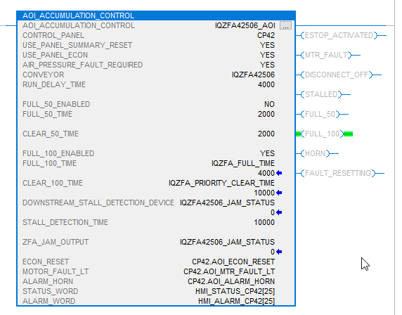
Plc add-on instructions
Standard code module
Requires download to change
Faceplate shows most necessary status.

Slide 17
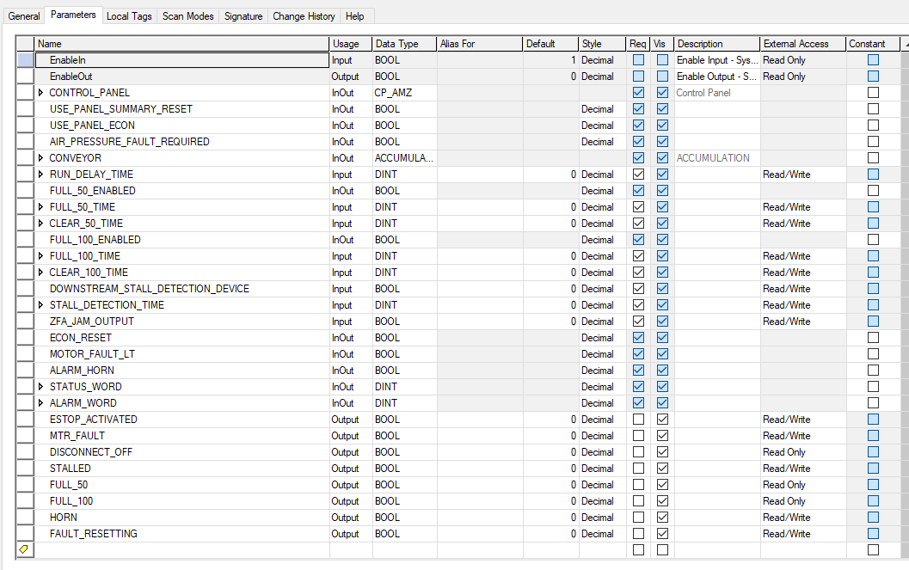
Plc add-on instructions
Standard code module
Requires download to change
Faceplate shows most necessary status.
Next level is Definition
Parameters shows relationship of faceplate constants and tags/variables.

Slide 18
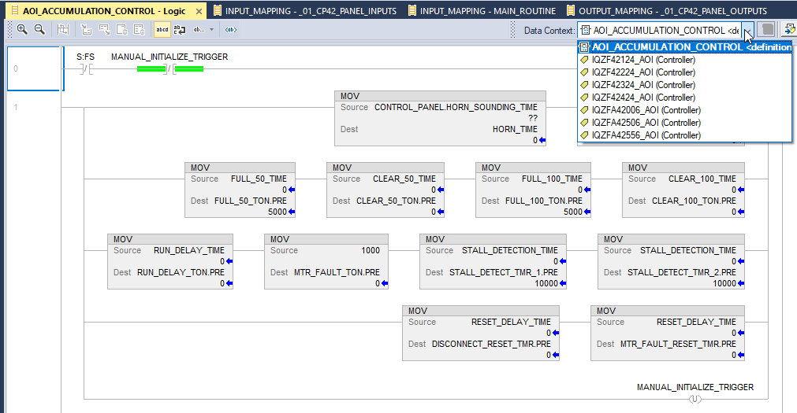
Plc add-on instructions
Standard code module
Faceplate – Definition - Logic
Logic view shows definition OR live instance data.
Internal / External data relates via definition & Parameters.
Troubleshooting problem:
All AOI refs show as destructive.
Why?

Slide 19
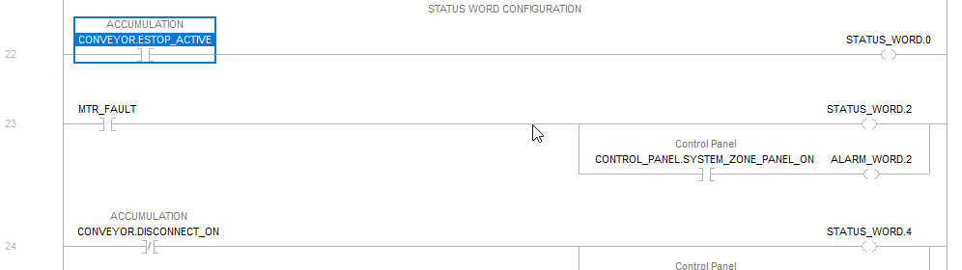
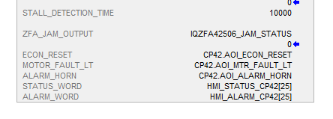
Plc add-on instructions
Internal / External data relates via definition & Parameters.
Example – observe STATUS_WORD in the AOI instance.
Checked faceplate – observe HMI_STATUS_CP42[25]

Slide 20
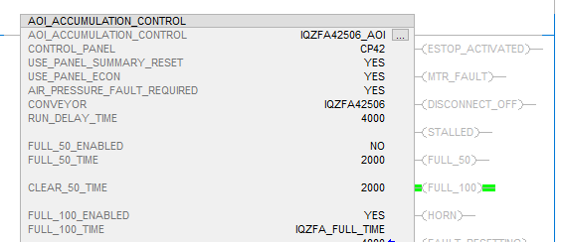
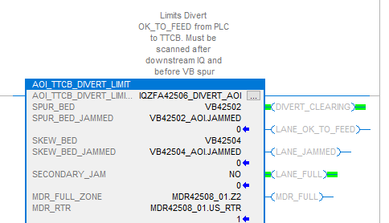
Plc add-on instructions
Intelligrated AOIs
General practice:
Initialize at beginning
AOIs capture one function per conveyor section – likely more than one exists.
Example: Accumulation Line
After-sort of TTCB

Slide 21
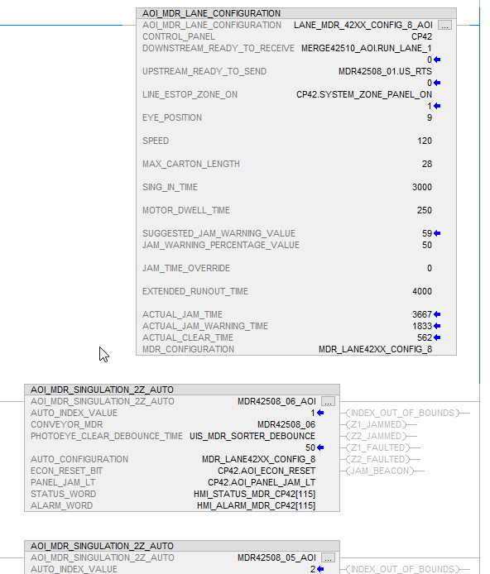
Plc add-on instructions
Intelligrated AOIs
NEW IN 2020:
MDR_LANE_CONFIGURATION
Auto-configures MDR ‘Lanes’.
Configured based on rung location:
Config AOI relates to Zone AOIs below it in the Routine.
Notice order of conveyors at right.

Slide 22
summary
PLC Controls Concepts
Be mindful of inter-panel connections – may be networked or hard-wired.
On production system, never download unless replacing processor.
Use ForceOn and ForceOff bits – toggle to alter I/O.

